Slide 1
DATA 621 HW5
Using Wine Quality Measurement to Predict Sales
Joby John, Jun Pan

Slide 2
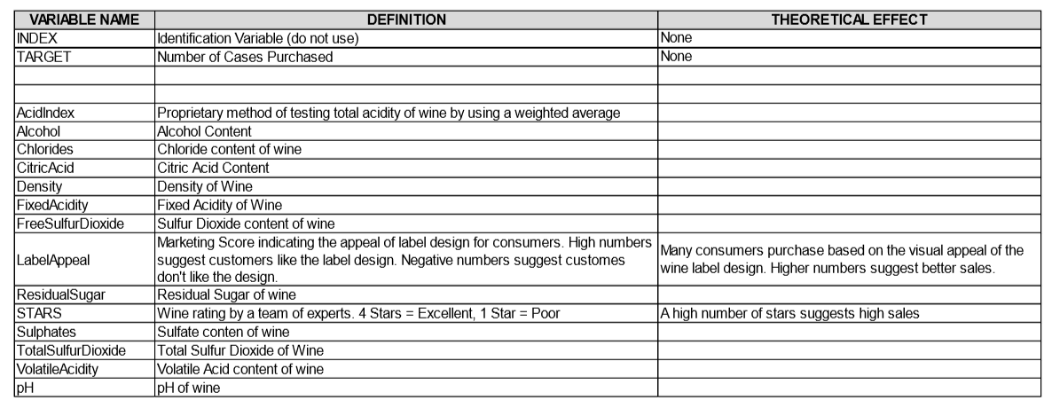

Slide 3


Slide 4
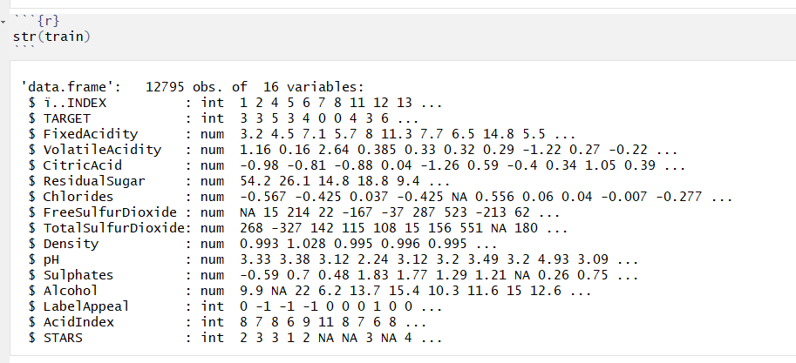
Overview Train Data
Train data has 12795 rows and 16 columns.
Besides, Label Appeal, AcidIndex and Stars are ordinal variables with transforming into integers. Other explanatory variables are numerical variables. TARGET is integer which records the number of box win being sold.

Slide 5
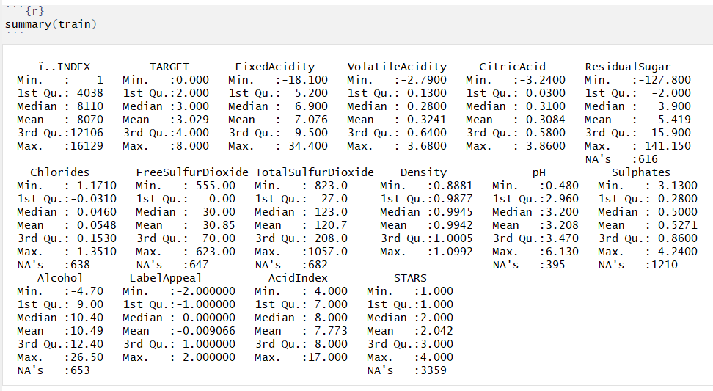
All independent variables are continous, except variables of `LabelAppeal`, `AcidIndex` and `STARS` are ordinal. These three ordinal variables represented by numeric values in logical order. The distances between categories/values can be considered equal . So these variables can be used in modeling as numeric variables.

Slide 6
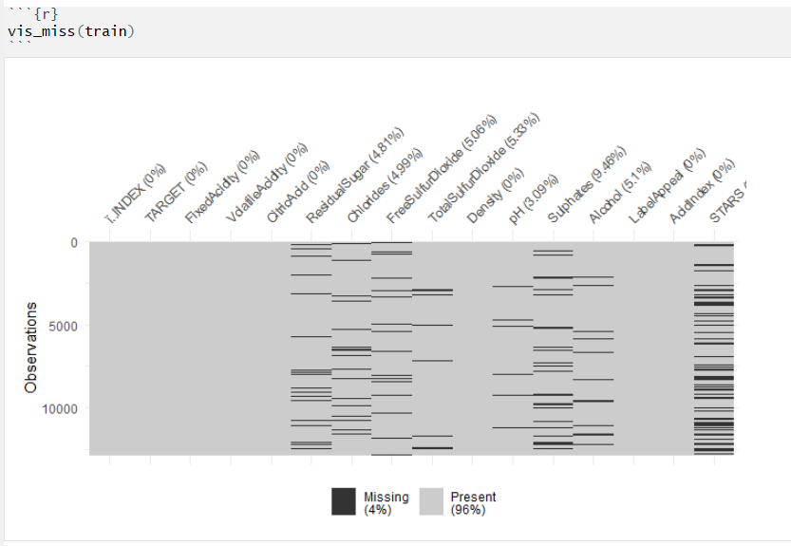
4% of Missing Data

Slide 7
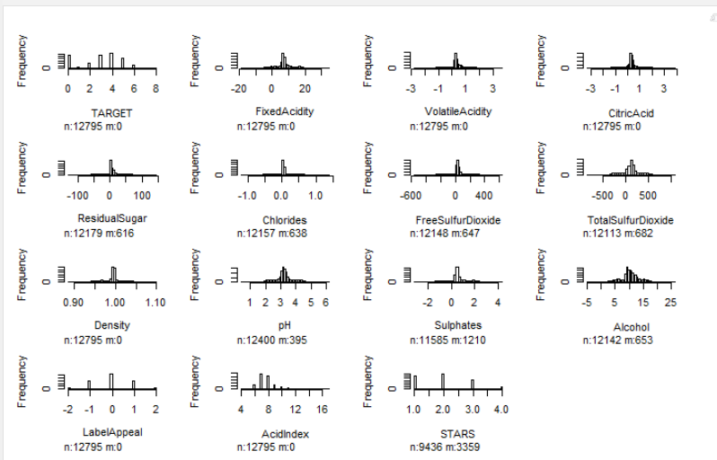
Histogram of all variables

Slide 8
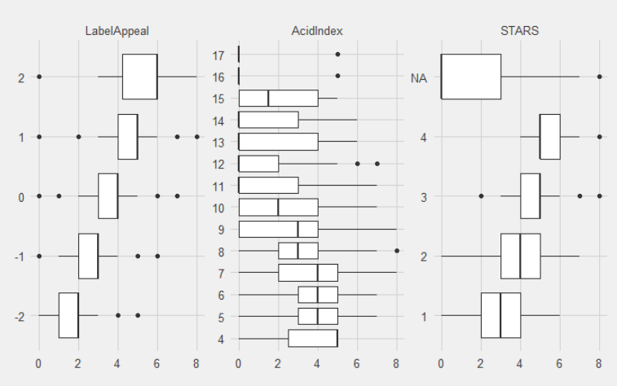
Box plot of 3 ordinal variables

Slide 9


Slide 10

Using Mice Package for Missing Data

Slide 11
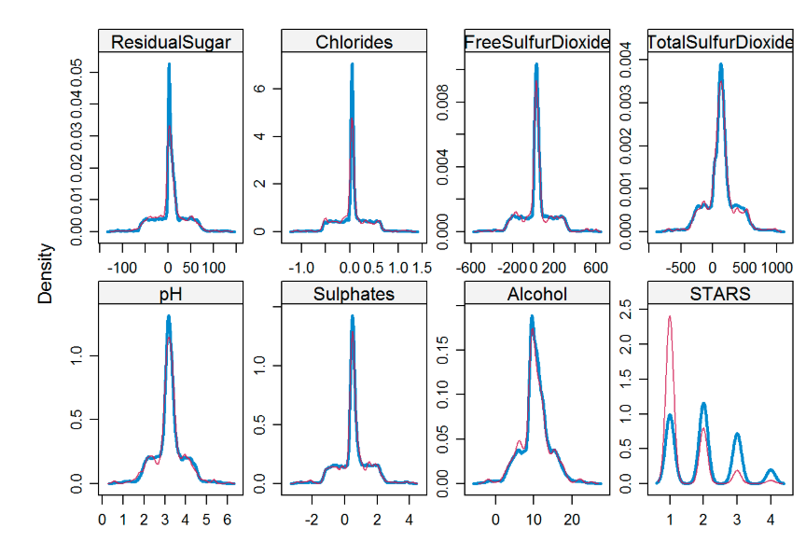
No Missing Data

Slide 12
Treat Outliers
Any outliers outside of lower 1.5IQR would be capped at 5th %ile, and observations above the upper 1.5IQR would be capped at 95th %ile.

Slide 13
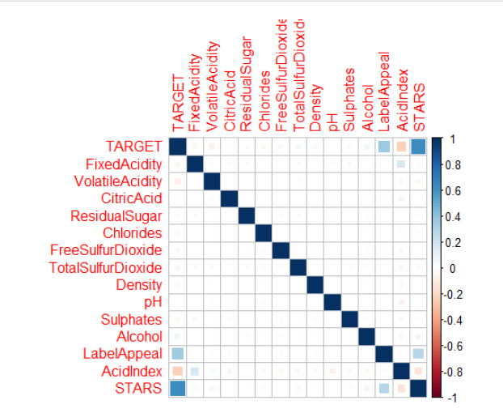
Correlation Plot

Slide 14

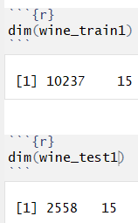
Split Train Data

Slide 15
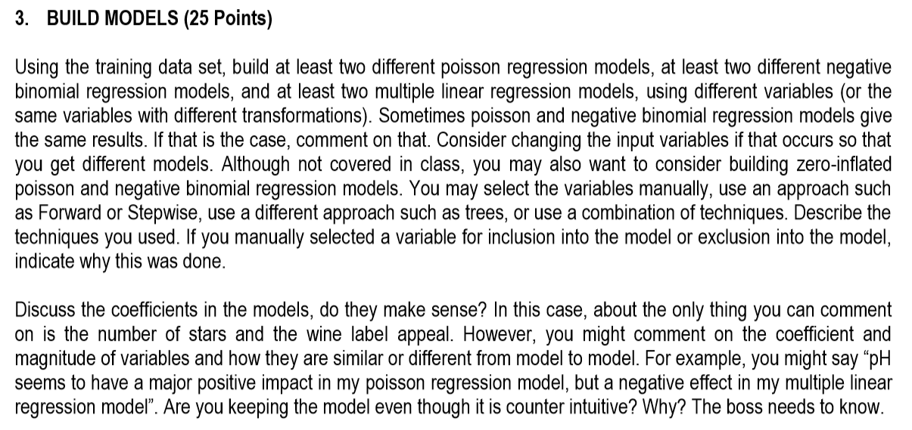

Slide 16
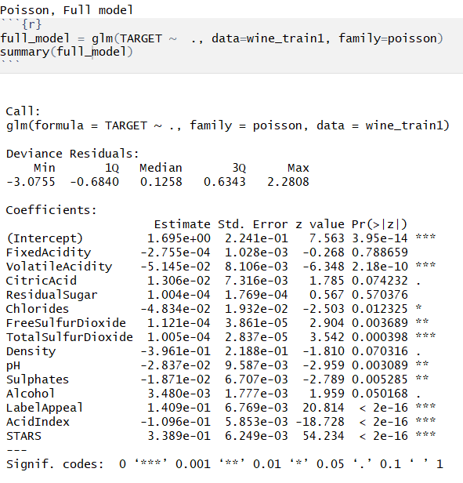

Poisson full_model

Slide 17
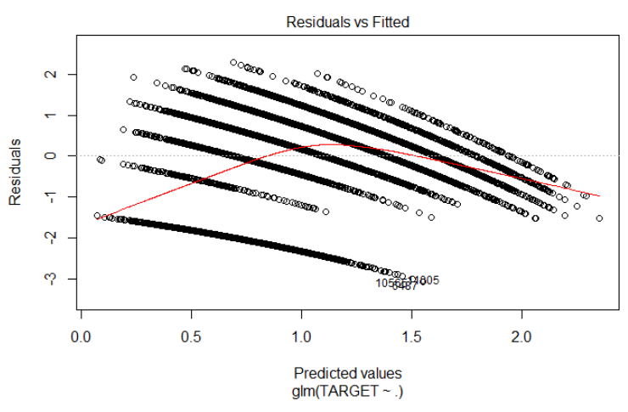
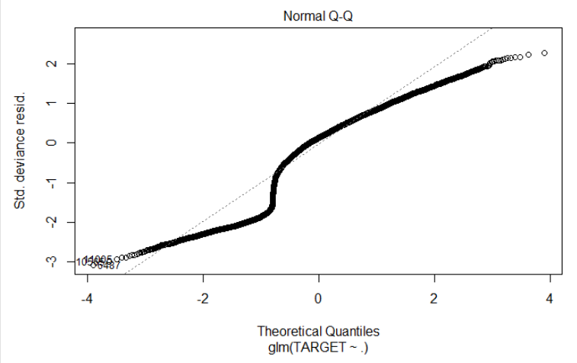
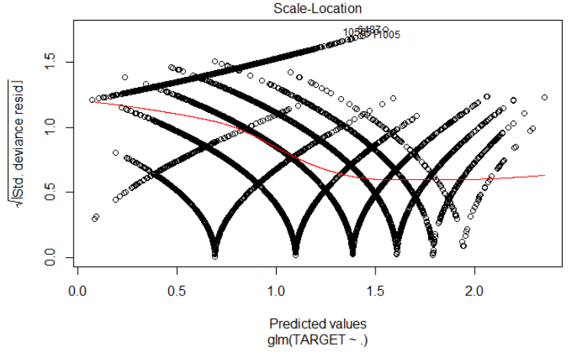
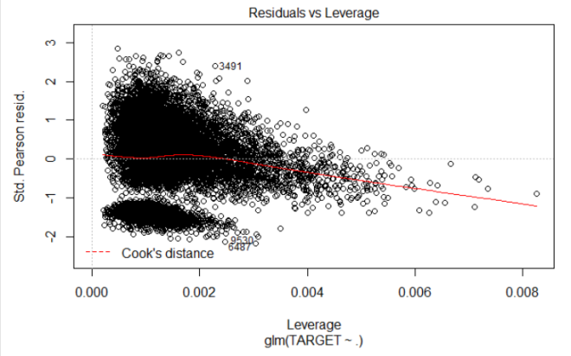
Plots of full_model

Slide 18
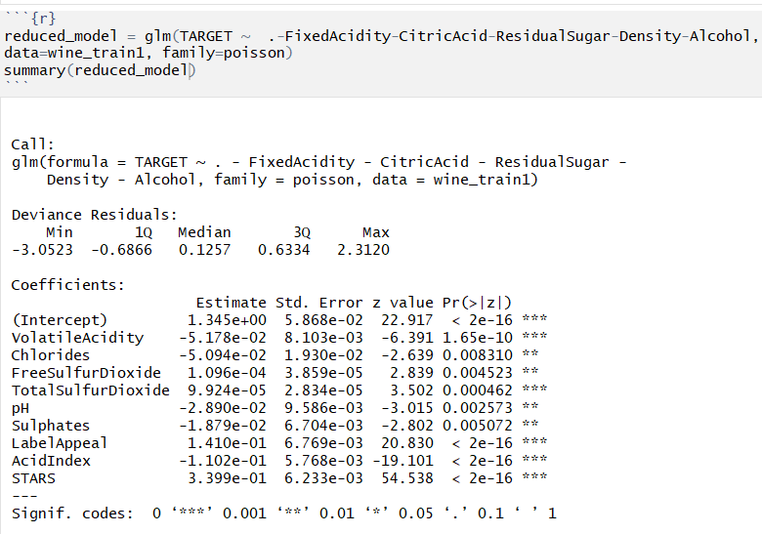

Poisson reduced_model

Slide 19
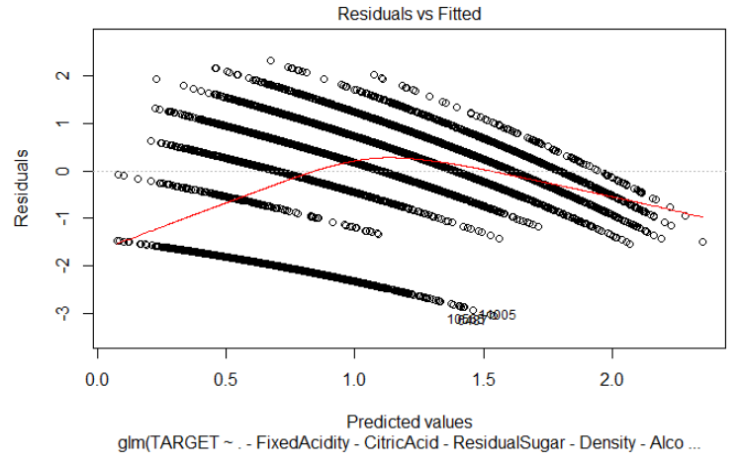
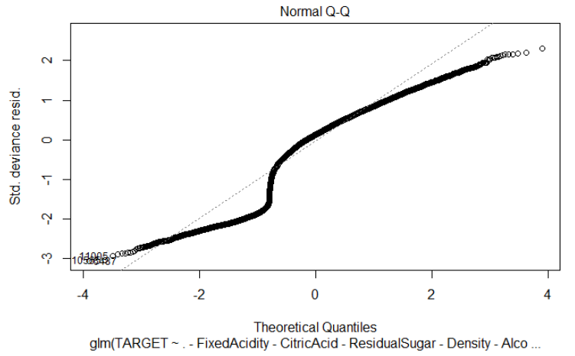
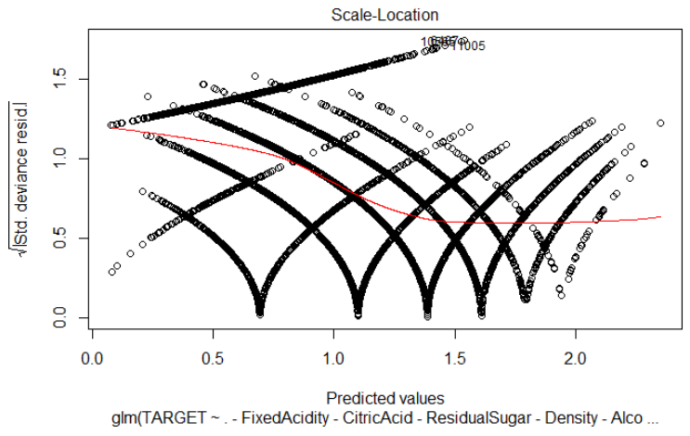
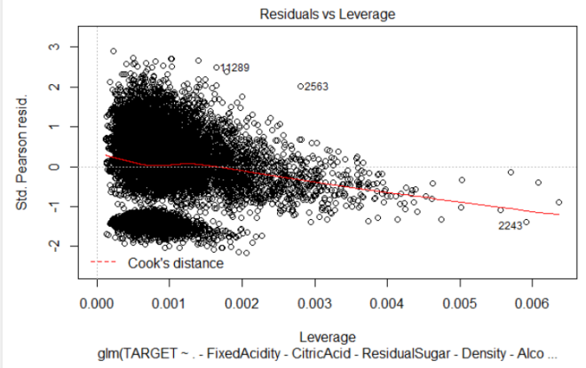
Plots of reduced_model

Slide 20

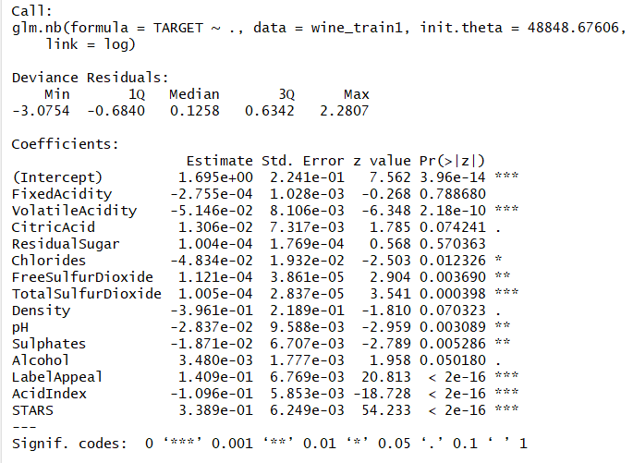
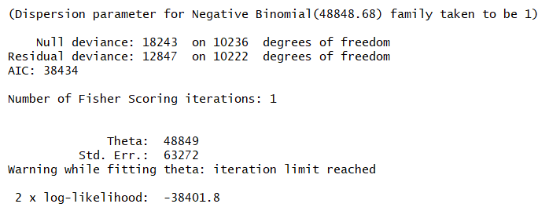
Negative Binomial Model

Slide 21
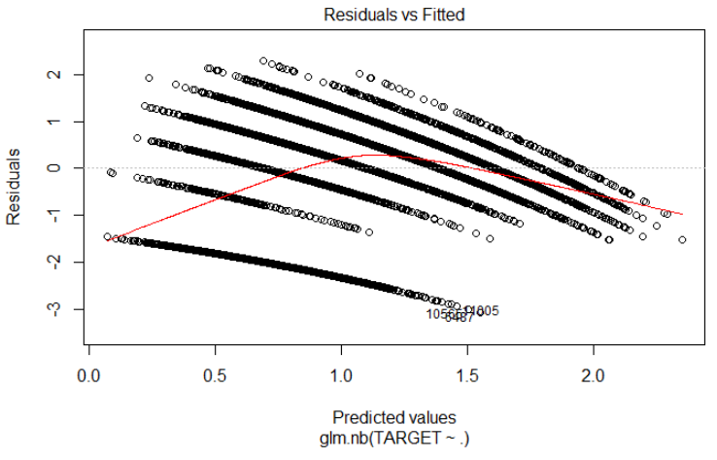

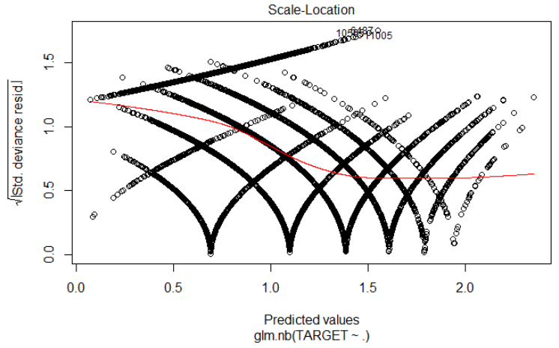
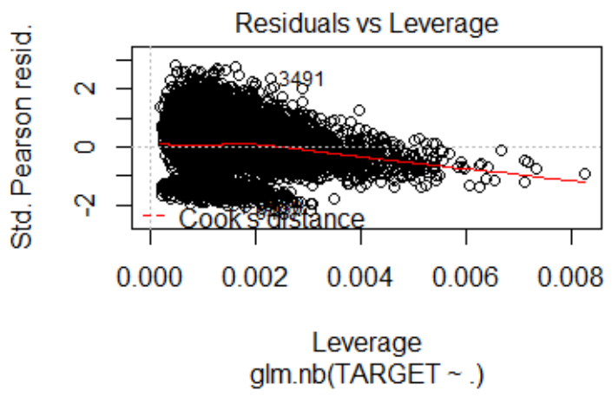
Plot of Negative Binomial Model

Slide 22

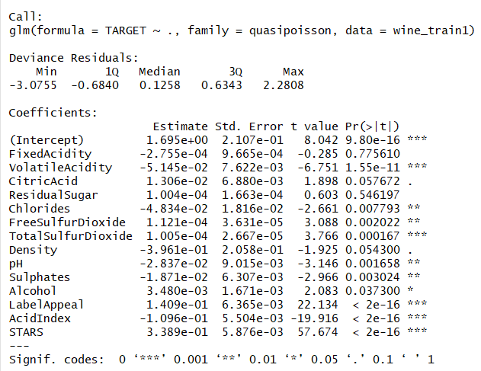

Quasi-Poisson Model

Slide 23
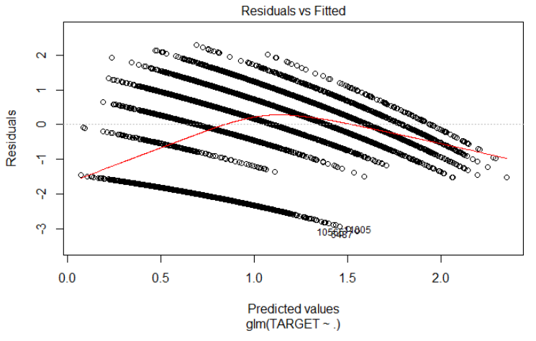

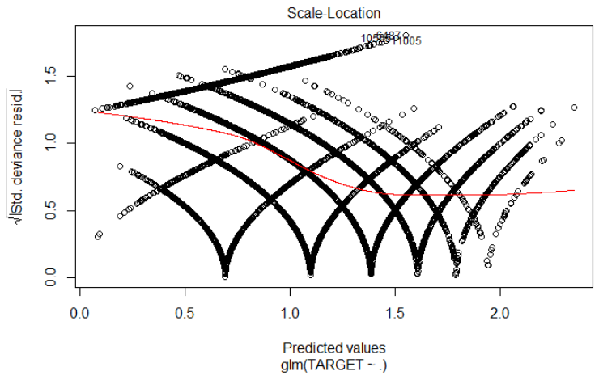
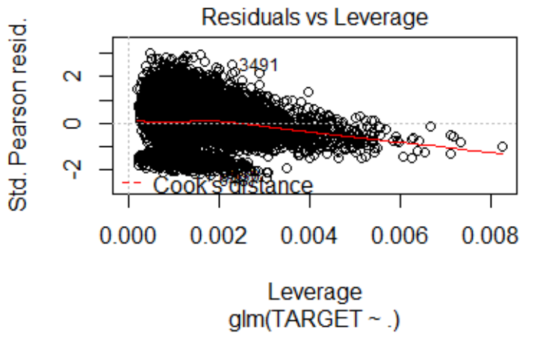
Plot of Quasi-Poisson Model

Slide 24

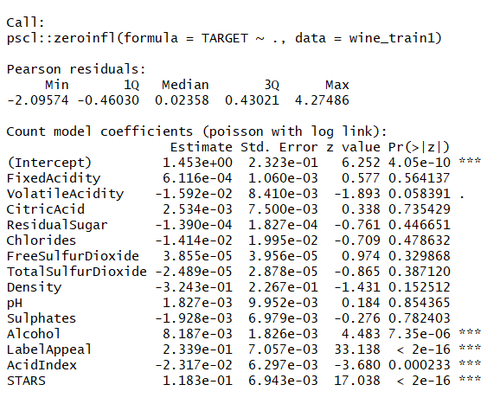
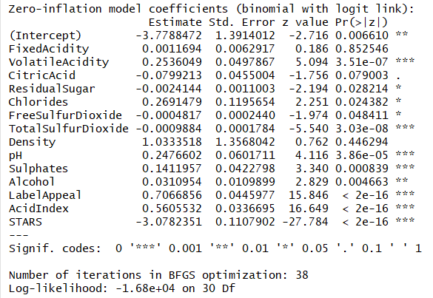
Zero Inflated Model

Slide 25
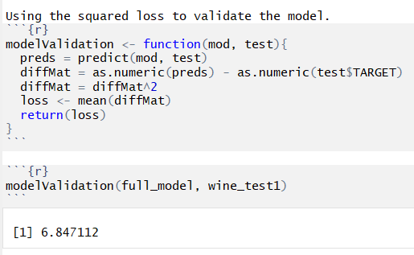

Model Validation Using Squared Loss

Slide 26




Slide 28


